Slide 1
PReeTHy’s shine
Professional Makeup Artist

Slide 2
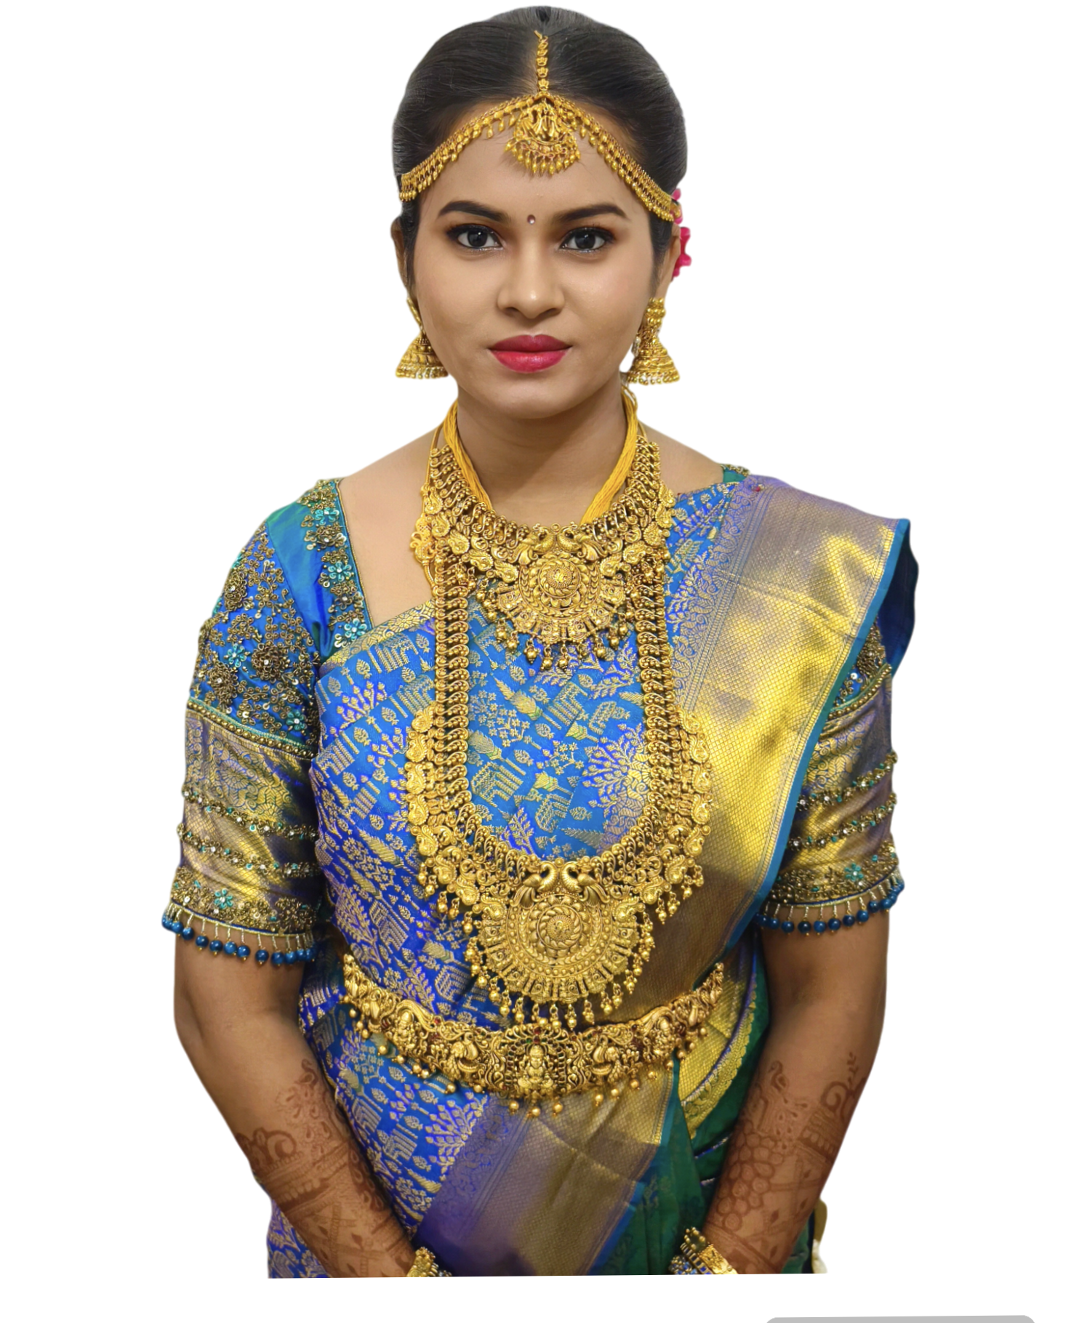
service
Makeup
Hairstyle
Saree pre pleating
Mehendi
Rental bridal jewellery
Retail imitation jewellery

Slide 3

Four types of packages
Silver package (Rs.500 – Rs.1000 – Rs.1500)
Golden package (Rs.2500 – Rs.3500 - Rs.5000)
Platinum package (Rs.7500 – Rs.10,000)
Diamond Package (Rs.12,000 – Rs.15,000 – Rs.20,000)

Slide 4
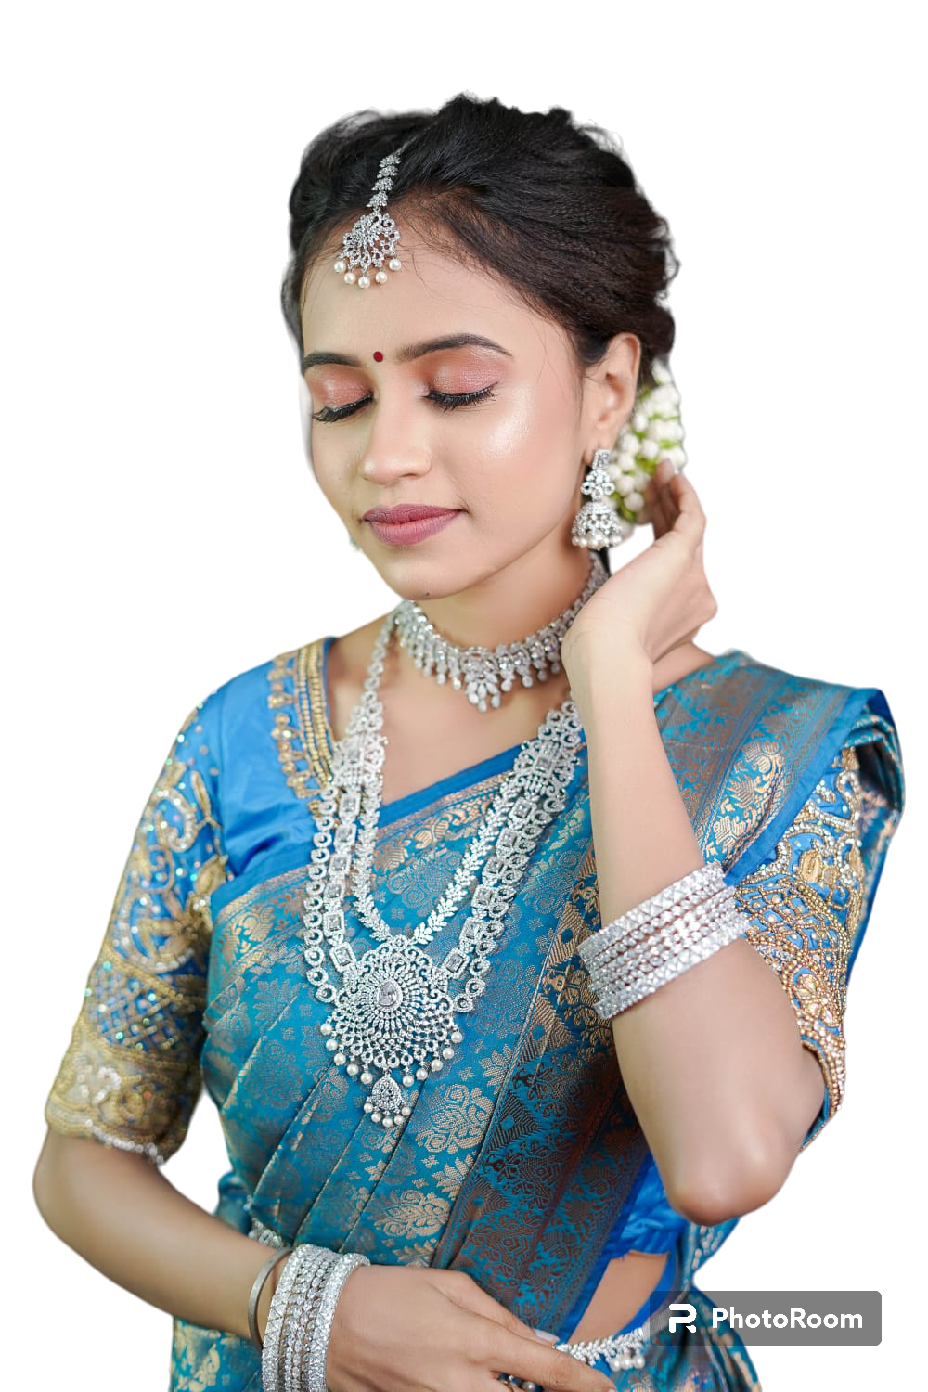
Silver package Guest makeup
MAKEUP:
Normal makeup – 500 (per head)
Glam look – 1000 (per head)
HAIR STYLE:
Note: Front variation as per your wish.
NO hair extension ,NO Crimping
Simple Jadai – 300(per head)
Messy hairstyle – 500 (per head)
BUN hairstyle – 500 (Per head)
SAREE DRAPING:
Single saree drape (ONSPOT) -300/-
Ironing + Draping – 500/-
Saree pre pleating & Box folding -300/350(based on saree material)

Slide 5
Golden package Brides maid makeup
Simple makeup – 1500/-
simple Makeup (No Lens, No Lash)
Basic Simple Hairstyle(only Sowri extension we provided ,No Crimping, NO curls)
ON SPOT Saree drape
HD Glow – 5000/-
Skin finish HD glow look (NO Lens ,NO Lash)
Any bridal Hairstyle
Single saree pre pleating box folding & draping
Complimentary Single Neck piece + stud
HD Makeup – 3500/-
Simple HD look (NO Lens ,NO Lash)
Hairstyle (Basic hairstyle,Sowri)
ON SPOT Saree drape

Slide 6

Market expansion
Unlocking new horizons

Slide 7
GOLDEN PACKAGE
Q1
Market research
Q2
Product development
Q3
User testing
Q4
Product launch
Currently gearing up for a ground-breaking launch
Our new offerings will captivate the market
Our marketing campaign will generate anticipation

Slide 8

Marketing strategies
Implement personalized engagement strategies
Tailor campaigns to resonate with specific demographics, fostering a sense of relevance and connection
Collaborate with influencers and thought leaders to amplify our brand message

Slide 9
Areas of focus
Our financial overview reflects a robust and resilient fiscal performance.
Key indicators show consistent revenue growth over the past quarter, attributed to strategic cost management and successful marketing.
Operating margins have improved, signaling operational efficiency, while strengthening our reserves.
This underscores our commitment to financial stability, positioning us for sustained growth.

Slide 10
Quarterly targets
Market expansion
Product innovation
Customer retention
Operational efficiency
Quarter | Revenue growth (%) | Market share increase (%) | Customer acquisition
Q1 | 12 | 2 | 500
Q2 | 15 | 3 | 600
Q3 | 18 | 4 | 700
Q4 | 20 | 5 | 800

Slide 11
Financial snapshot
Metric | Current value | Previous quarter | Change (%)
Revenue | $2,500,000 | 2,200,000 | +14%
Operating expenses | $1,200,000 | $1,400,000 | -14%
Net profit | $1,000,000 | $800,000 | +25%
Operating margin | 40% | 36% | +4%
Cash reserves | $5,000,000 | $4,500,000 | +11%

Slide 12
Future initiatives
Product enhancement. Introduce regular updates and features to enhance product offerings.
Technology integration. Explore emerging technologies for potential integration into our operations.
Collaborative partnerships. Foster collaborations with tech innovators and industry leaders to drive innovation.
Green supply chain
Reduced carbon footprint
Waste reduction
Water conservation

Slide 13
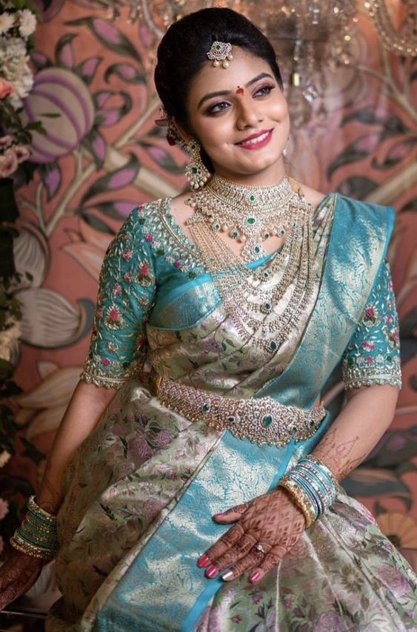

THANK YOU
Mirjam Nilsson​
mirjam@contoso.com
contoso.com

